Slide 1
Implementing Logic Gates Using Artificial Neural Network
Bedram Tamang
14/2075
tmgbedu@gmail.com
https://bedramtamang.com.np

Slide 2
Objectives
To study and research core theme of machine Learning.
To Study how a machine can mimic a human brain with perceptron.
To study linearly separable and linearly non separable problem in ANN

Slide 3
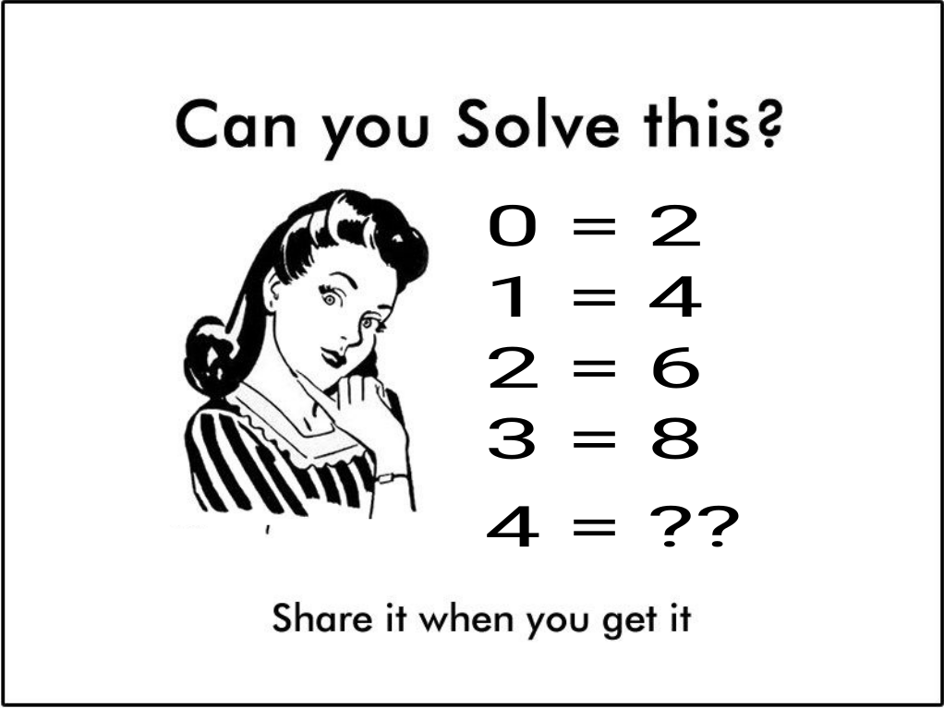
Let’s Check Facebook.
I found this troll.

Slide 4
Okay Great !
Answer is 10.
But how did you get this answer ?
  You did hit and trail.
  And found a hidden rule.
  if input is a, then output a*2+2
  You predicted the output is 10.
  What you just did is your Intelligence

Slide 5
Can we make a machine function as our brain what it did just right now ?

Slide 6
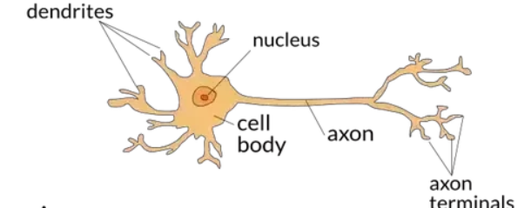
Let’s observe Our brain
Brain consists a basic func
-tional unit called neuron.
signals can be received
from dendrites, and sent
down to the axon once enough signals were received.
This outgoing signal can then be used as another input for other neurons

Slide 7
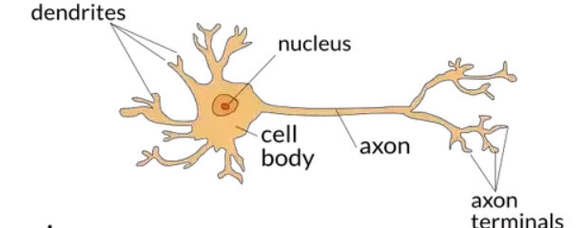
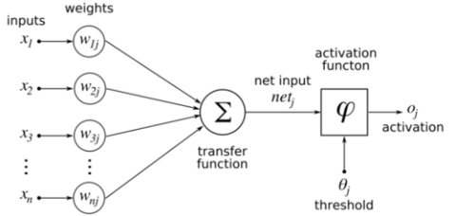
Let’s try to mimic our brain

Slide 8
Perceptron
The artificial brain that we just made is called Perceptron.
A perceptron is a single processing unit of a neural network.
A single artificial neuron that computes its weighted input and uses a threshold activation function.

Slide 9
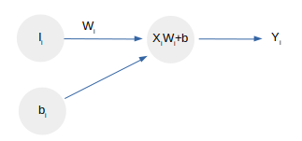
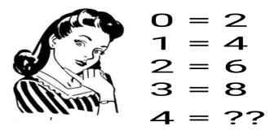
Let’s back to the example.
Initially W₁=1 & b₁=1
Inputs | x_{i} * w_{i}+b | output | Expected | Error
0 | 1 | 1 | 2 | 1
1 | 2 | 2 | 4 | 2
2 | 3 | 3 | 6 | 3
3 | 4 | 4 | 8 | 4
Total Error for first iteration=10

Slide 10
Cont...
To make our machine learn that example we should minimize the error by adjusting the weights.
But error can be +Ve and -Ve, So accumulated Error can be 0, so we can’t minimize the error.
We can take absolute value of error, but there is no mathematical way to minimize absolute function other than HIT and Trail method.
So we are interested in square of Error.

Slide 11
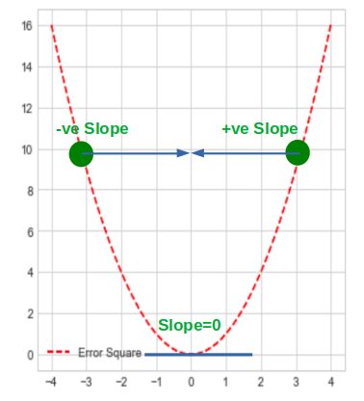
Learning Rule Cont...
w=w-Slope
But it may overshoots the
minimum
So, w = w-η * slope
where η = Learning rate
Error²=1/2 ∑ (t − a) ²,
where a= ∑x_{i}w_{i} and
t = expected output
A
B

Slide 12
Learning Rule Cont...
dE(p)/Dw=(t − a)(−x_{i})
∆W = η(t − a)(−x _{i} )
This rule is called gradient descent rule.
New Weight = w - ∆W

Slide 13
But,
Where Is the Logic gates ?

Slide 14
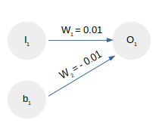
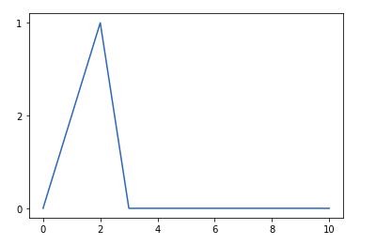
Not Gate Implementation
Not gate converges in less than 10 epoch, with learning rate 0.01 and weight is 0.01 and bias is
-0.01

Slide 15
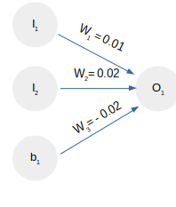
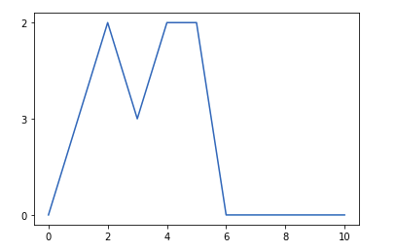
AND gate implementation
AND gate converged in less than 10 epoch, with learning rate 0.01 and weight were 0.01, 0.02 and bias was -0.02

Slide 16
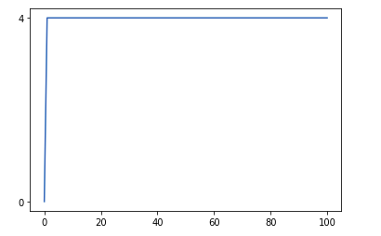
Let’s Try XOR gate
Error Graph of XOR gate implementation

Slide 17
Oops !!!
It even can’t solve XOR problem.
The first AI winter (1974–1980)
Back propagation was introduced by John Hopfield in 1982.

Slide 18
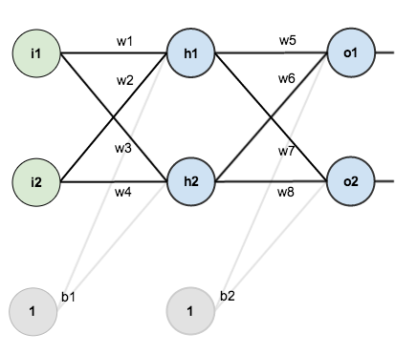
Multi-layer Perceptron/
Back-propagation

Slide 19
Back-propagation Cont...
Feed Forward Network
h₁ = i ₁ ∗ w₁ + i ₂ ∗ w ₂ + b₁
h₂ = i ₁ ∗ w₃ + i ₄ ∗ w ₂ + b₁
o₁ = h₁ ∗ w₅ + h₂ ∗ w₆ + b ₂
o₂ = h₁ ∗ w₇ + h₂ ∗ w₈ + b ₂
And each node output goes to the next layer passes through sigmoid activation function. for example, output at o₁ is given by,
Out o₁ =1/(1 + e ^{−o}₁)
Error = ∑ (t − o) where t = target output and o = result output
E_{total} =1/2∑(t₁ − o₁)² + (t₂− o₂)²

Slide 20

Back-propagation Cont...
w₅ = w₅ − η ∗ ∂E_{total}/∂w₅
∂ E _{total}/∂ w₅= −(t₁ − Out o₁) ∗ Outo₁∗(1−Outo₁ ) ∗ Out h₁
Similarly,
w₆ = w₆ − η ∗ ∂E_{total}/∂w₆
For Hidden layer weights,
w₁ = w₁ − η*∂ E_{total}/∂w₁

Slide 21
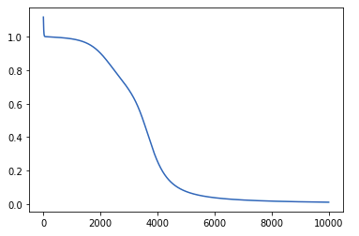
Let’s Try XOR again
Prediction results the expected output, but it required almost 10,000 ephos to get converged with learning rate 0.1, We can observe the error function during the convergence as below.

Slide 22
I am Done.

Slide 23
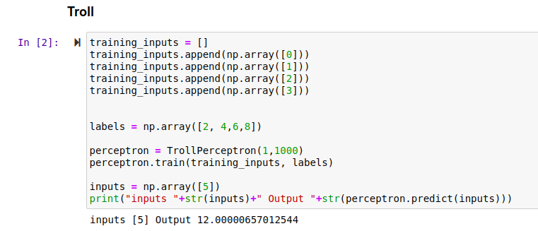
But, what about the TROLL ?

Slide 24
Conclusion Note:
The fundamental concept of single and multi-layer perceptron was understood.
The theoretical concept was implemented.
A error minimization technique: Gradient Descent was learned.
And many more.

Slide 25
Beyond this report...
Artificial intelligence has been in the hive for more than 5-6 decades. It faces several ups on downs during its early research and developments. Now It seems like AI’s been doing perfect jobs in some general Artificial intelligence like: games, or some specific tasks. But there are still a lot of fields where AI was defeated.

Slide 26
Thanks

Slide 27
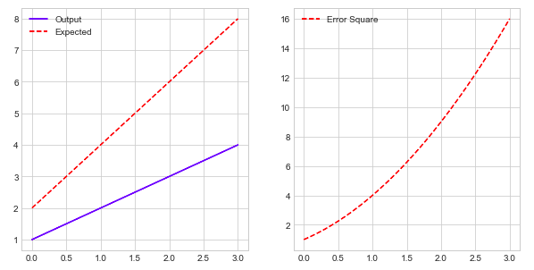
Learning Rule

